Slide 1
Unit 3 Lecture 9

Slide 2
TCP/IP (Transmission Control Protocol/Internet Protocol) Suite:
The TCP/IP protocol suite was defined as having four layers: host-to-network, internet, transport, and application.
However, when TCP/IP is compared to OSI, we can say that the host-to-network layer is equivalent to the combination of the physical and data link layers.
The internet layer is equivalent to the network layer, and the application layer is roughly doing the job of the session, presentation, and application layers with the transport layer in TCP/IP taking care of part of the duties of the session layer

Slide 3
TCP/IP is a hierarchical protocol made up of interactive modules, each of which provides a specific functionality; however, the modules are not necessarily interdependent.
Whereas the OSI model specifies which functions belong to each of its layers, the layers of the TCP/IP protocol suite contain relatively independent protocols that can be mixed and matched depending on the needs of the system.
The term hierarchical means that each upper-level protocol is supported by one or more lower-level protocol

Slide 4
At the transport layer, TCP/IP defines three protocols: Transmission Control Protocol (TCP), User Datagram Protocol (UDP), and Stream Control Transmission Protocol (SCTP).
At the network layer, the main protocol defined by TCP/IP is the Internetworking Protocol (IP); there are also some other protocols that support data movement in this layer.

Slide 5
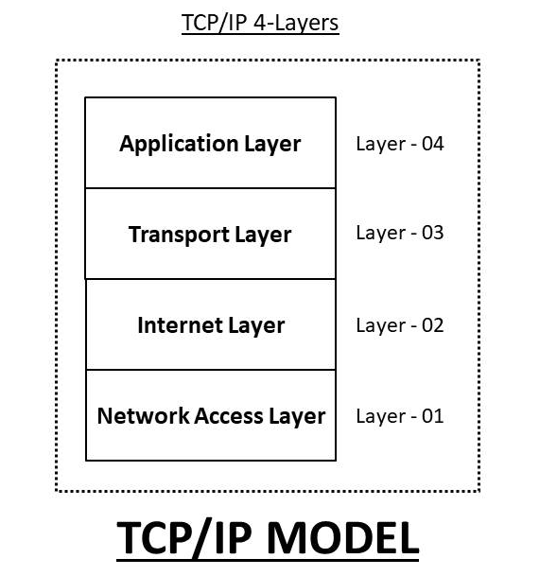

Slide 6
1. Host-to-Network Layer:
The TCP/IP reference model does not really say much about what happens here, except to point out that the host has to connect to the network using some protocol so it can send IP packets to it.
This protocol is not defined and varies from host to host and network to network.

Slide 7
2. Internet Layer:
Its job is to permit hosts to inject packets into any network and have they travel independently to the destination (potentially on a different network).
They may even arrive in a different order than they were sent, in which case it is the job of higher layers to rearrange them, if in-order delivery is desired.
The internet layer defines an official packet format and protocol called IP (Internet Protocol).
The job of the internet layer is to deliver IP packets where they are supposed to go.
Packet routing is clearly the major issue here, as is avoiding congestion.

Slide 8
3. The Transport Layer:
The layer above the internet layer in the TCP/IP model is now usually called the transport layer.
It is designed to allow peer entities on the source and destination hosts to carry on a conversation, just as in the OSI transport layer.
Two end-to-end transport protocols have been defined here. The first one, TCP (Transmission Control Protocol), is a reliable connection oriented protocol

Slide 9
It allows a byte stream originating on one machine to be delivered without error on any other machine in the internet.
It fragments the incoming byte stream into discrete messages and passes each one on to the internet layer
The second protocol in this layer, UDP (User Datagram Protocol), is an unreliable, connectionless protocol for applications that do not want TCP's sequencing or flow control and wish to provide their own.

Slide 10
4. The Application Layer:
The TCP/IP model does not have session or presentation layers.
On top of the transport layer is the application layer. It contains all the higher-level protocols.
The early ones included virtual terminal (TELNET), file transfer (FTP), and electronic mail (SMTP).
The virtual terminal protocol allows a user on one machine to log onto a distant machine and work there.
Many other protocols have been added to these over the years eg The Domain Name System (DNS) for mapping host names onto their network addresses

Slide 11
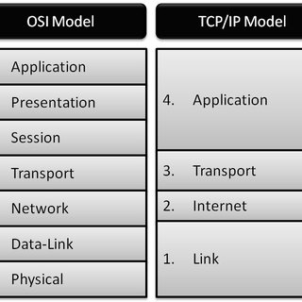
OSI Vs TCP/IP

Slide 12
Comparison of the OSI and TCP/IP Reference Models:
The OSI and TCP/IP reference models have much in common.
Both are based on the concept of a stack of independent protocols.
Also, the functionality of the layers is roughly similar.
For example, in both models the layers up through and including the transport layer are there to provide an end-to-end, network- independent transport service to processes wishing to communicate.

Slide 13
Again, in both models, the layers above transport are application-oriented users of the transport service.
Despite these fundamental similarities, the two models also have many differences Three concepts are central to the OSI mode

Slide 14
Services
Interfaces
Protocols

Slide 15
Probably the biggest contribution of the OSI model is to make the distinction between these three concepts explicit.
Each layer performs some services for the layer above it.
The service definition tells what the layer does, not how entities above it access it or how the layer works.
It defines the layer's semantics.
A layer's interface tells the processes above it how to access it.
It specifies what the parameters are and what results to expect.
It, too, says nothing about how the layer works inside.

